Slide 1
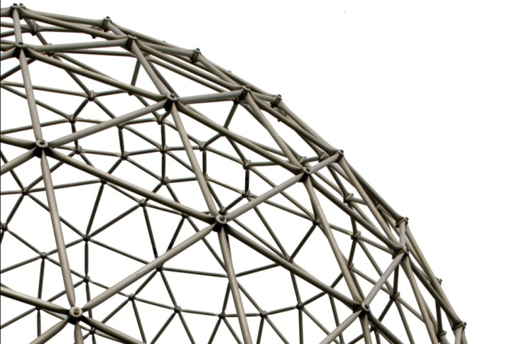
CS441 Foundations of Digital Transformation Lecture 14: The Internet of Things – Part 2 IoT Architecture
Ravi Mittal
ravi.mittal@iitgoa.ac.in
Indian Institute of Technology, Goa

Slide 2
Contents
Gartner Hype Curve for IoT
IoT system and Architecture
IoT Hardware
IoT and Digital Transformation

Slide 3
Gartner Hype Curve for IoT

Slide 4
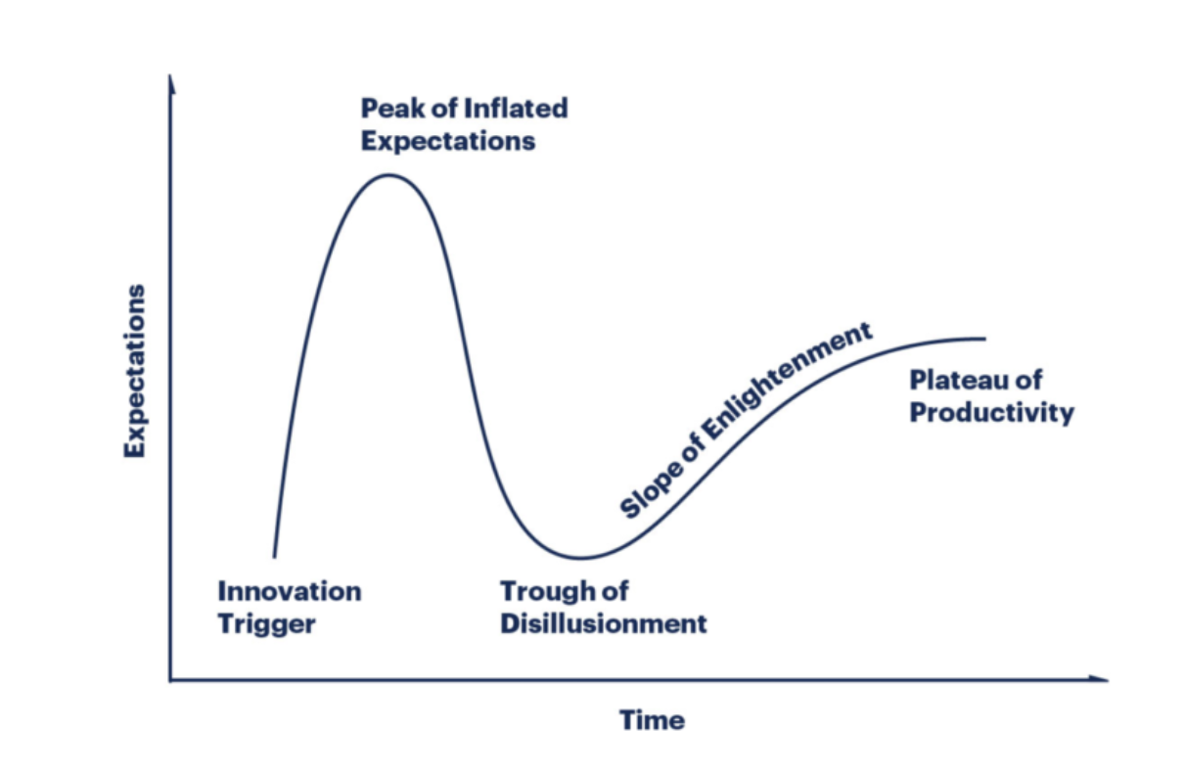
Gartner Hype Cycle

Slide 5
The Gartner Hype Cycle
It is a graphical representation of the perceived value of a technology trend or innovation—and its relative market promotion
It shows how the perceived value of a given technology evolves over the course of its maturity lifecycle
Phases:
Innovation Trigger
Peak of Inflated Expectations
Trough of Disillusionment
Slope of Enlightment

Slide 6
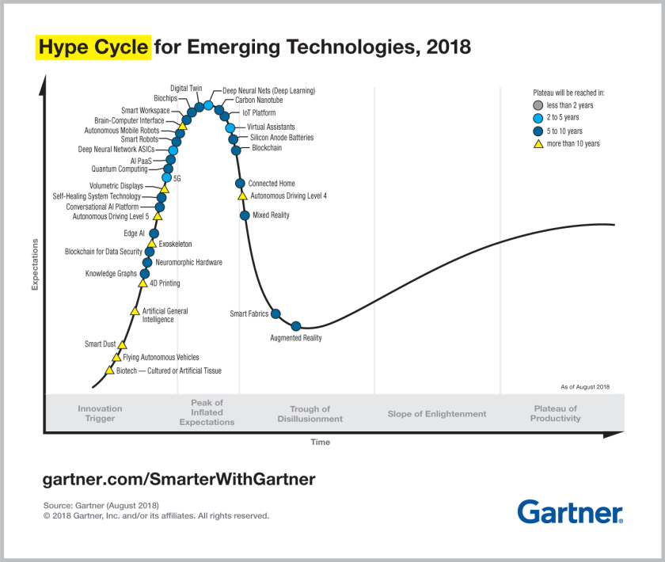
Emerging Technologies - Hype Cycle

Slide 7
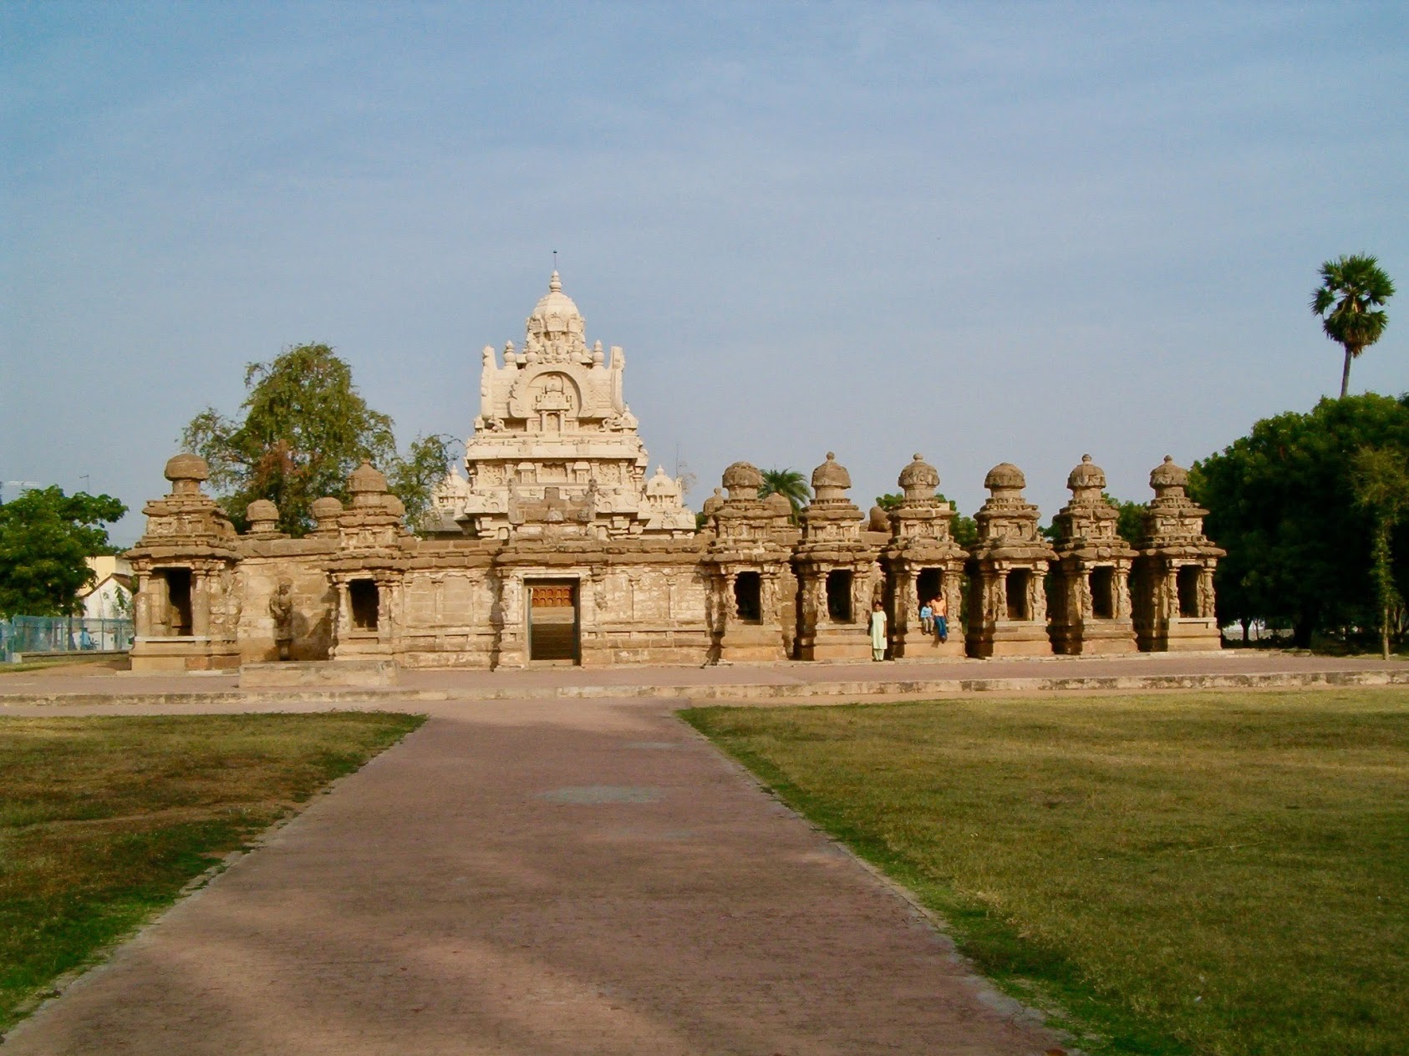
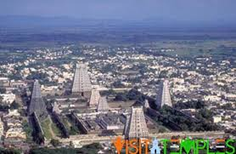
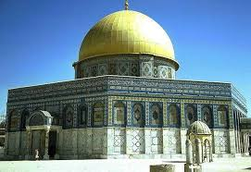

IoT System and Architecture
Different Architectures

Slide 8
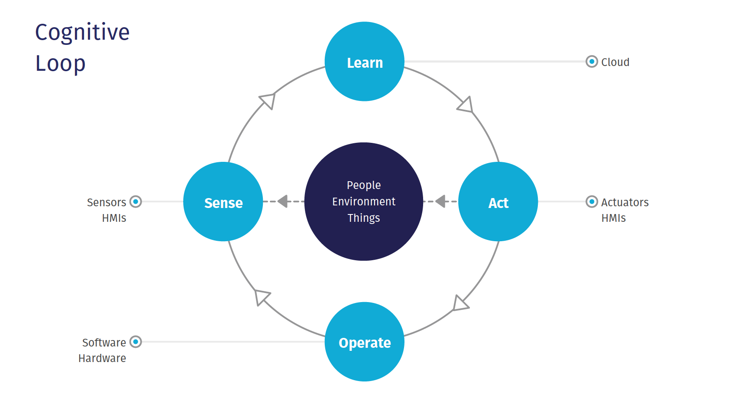
SEI Architecture

Slide 9
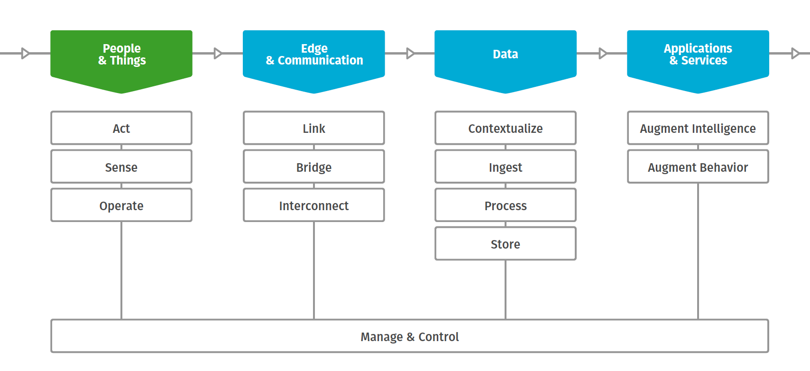
SEI – Architecture – Reference Model

Slide 10
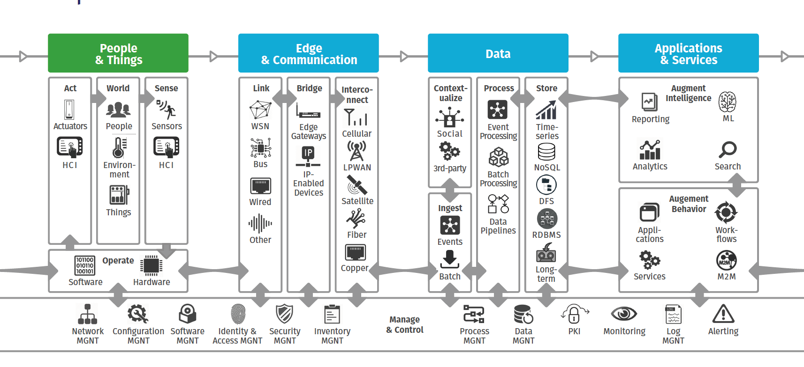
SEI – Reference Model Implementation View

Slide 11
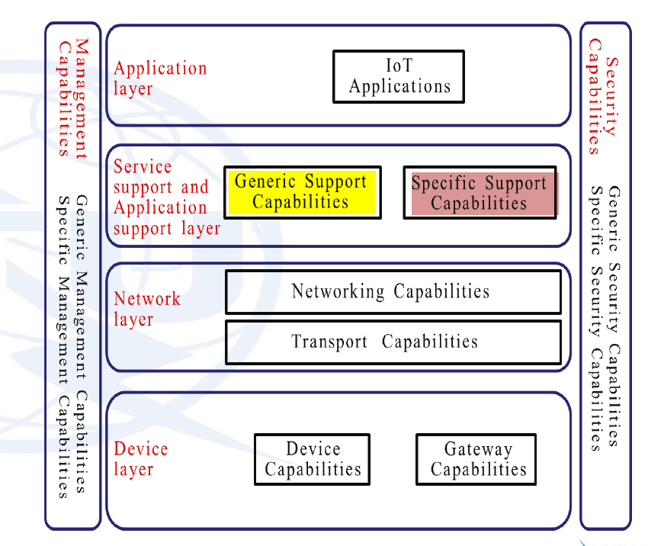
ITU Reference Model

Slide 12
IoT Architecture - Hardware

Slide 13
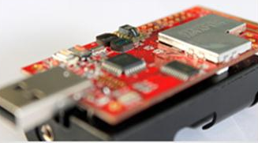
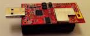
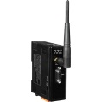

Overview: Hardware Platform
IEEE 802.15.4 2.4GHz RF System
User/Environment
2 sensors
“Thing”
Sensors & Actuators
XM1000
Device level
Communications
Network
Gateway
The Internet
Network level
The Internet
Servers

Slide 14
IoT Organization
Internet of Things (IoT) has five parts
Sensors: To sense and collect data about environment
Smart thermostats, Street and highway sensors, Smartphones with their motion sensors and GPS location receivers, Industrial sensors
Tiny, cheap, Variety
Processors and Memory: to store data and to figure out what to do with the data coming from sensors and users; Microcontroller
Within individual devices (cheap miniature computer)
Actuators: Mainly output components
They alter the surroundings: Adding lighting, heat, sound, controlling motors to move objects, Displaying messages etc
The connecting network: The Internet, and low level networks
Power supply, Battery
The Cloud
RaviMittal@iitgoa

Slide 15
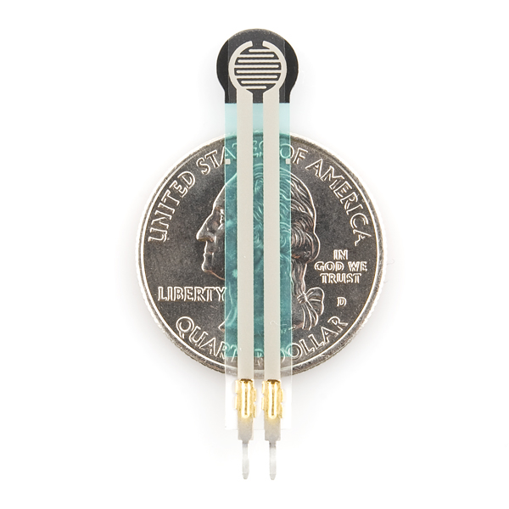
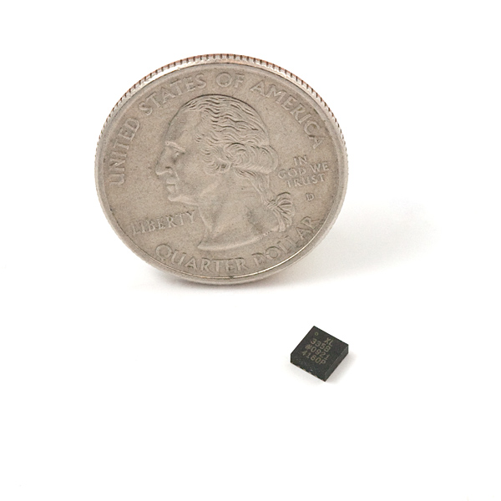
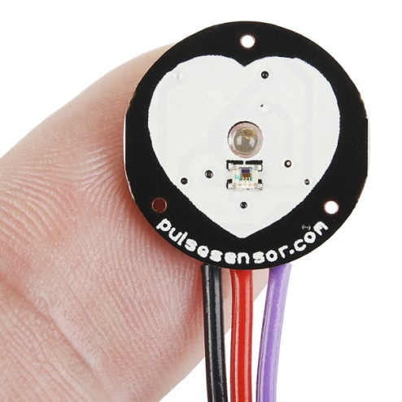
Sensor Technology
Accelerometer
(4mm diameter)
Force Sensor
(0.1N – 10N)
Pulse Sensor
$25
https://www.sparkfun.com/
https://www.adafruit.com/

Slide 16
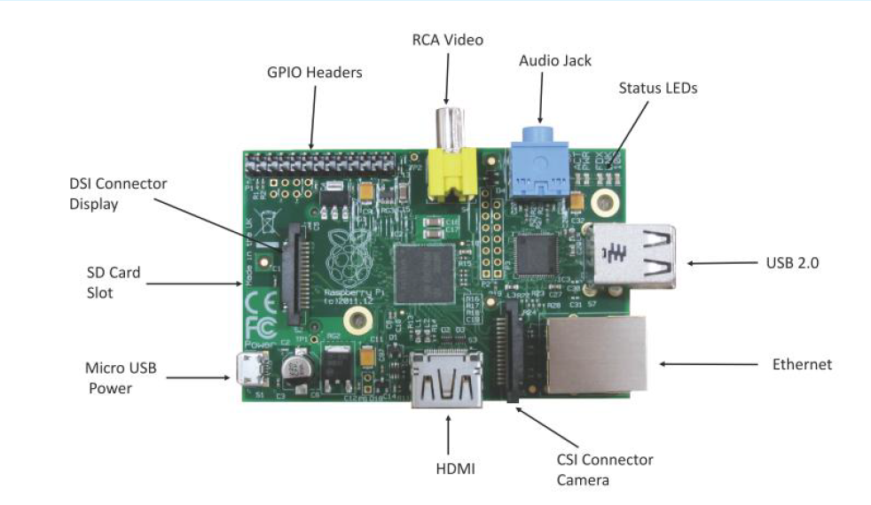
Cheap Mini Computer
Low-cost mini-computer with the physical size of acredit card
Runs various flavors of Linux and can perform almost all tasks that a normal desktop computer can do
Interfaces for sensors and actuators through the general purpose I/O pins
Supports Python

Slide 17
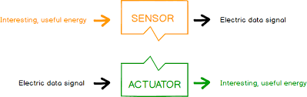
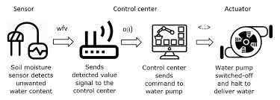
Actuators

Slide 18
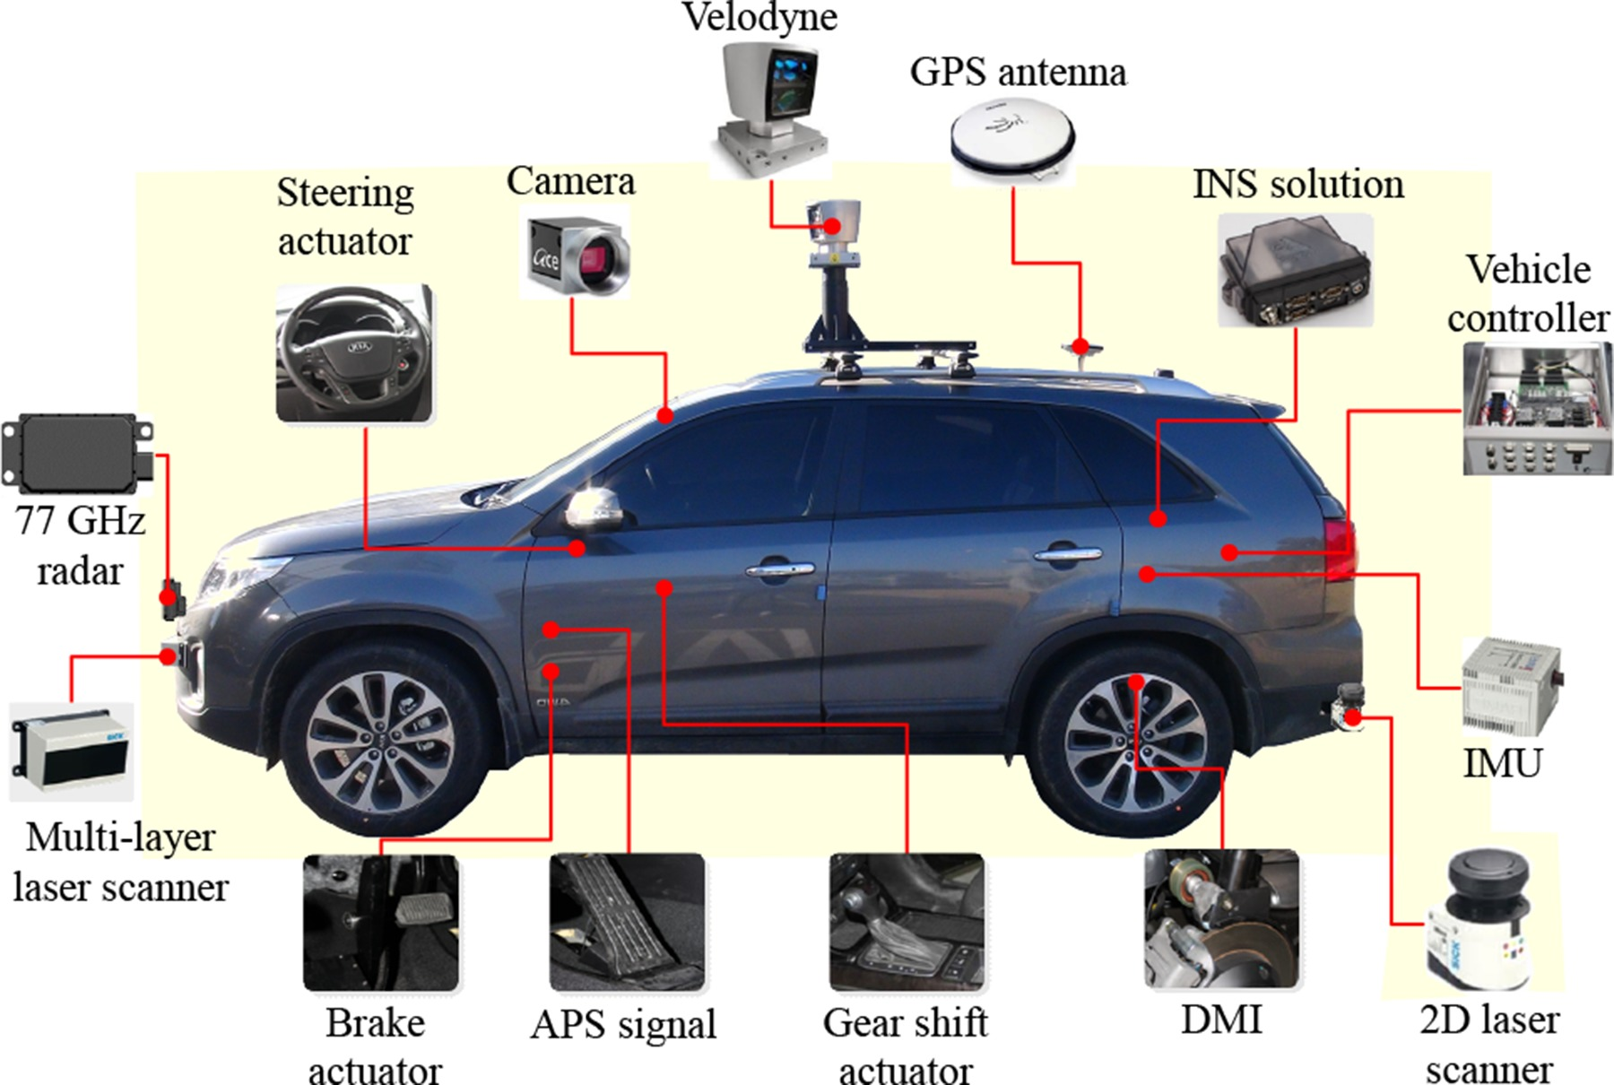
Sensors and Actuators in a self driving car
Source: Wiley online library

Slide 19

The Internet
The Internet serves as a wide area networking for a local network
The Internet uses TCP/IP. This implies that things must also support TCP/IP
Gateway (or sink)
For a practical deployment, a gateway is often needed in a network
It offers relaying packets between the network and the Internet
The Internet
Data link
Gateway
Network

Slide 20
Data is the key
Analysis and use of data → value addition
Data analysis + Intelligence → Innovative and transformational smart solutions and services

Slide 21
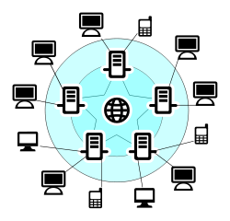




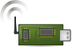
Data collection
Data
Data
Sender
Receiver
A sample data communication in conventional networks
Fire!
Some bits
01100011100
Core network
e.g. Internet
End-user
Sink
node
Gateway
A sample data communication in WSN

Slide 22
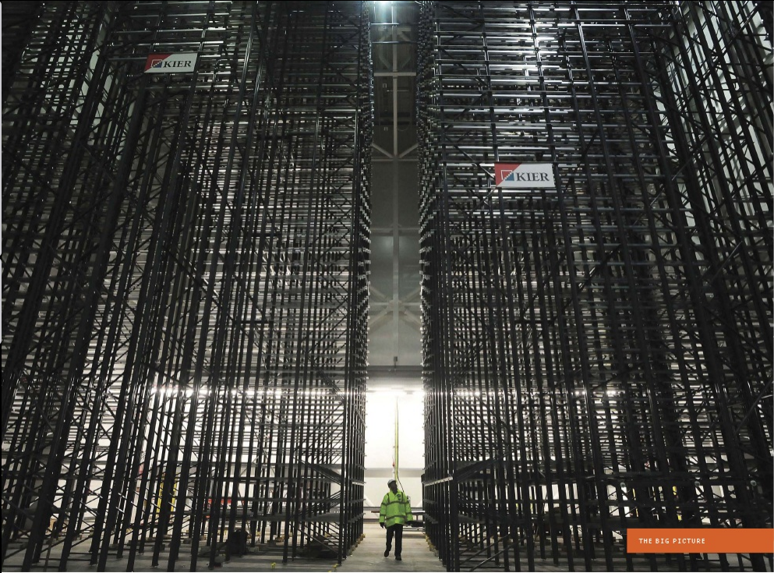
Storing, Handling and Processing the Data
Image courtesy: IEEE Spectrum

Slide 23
IoT and Digital Transformation

Slide 24
Software Platforms and Services
Operating Systems and execution environments
Contiki, TinyOS
Relevant protocols and standards
6LoWPan, CoAP
Architecture reference models
ETSI M2M architecture and components
Gateway/middleware

Slide 25
Leveraging IoT data in the organization
Following activities can take advantage of IoT Engineering
Remote monitoring and control
Manufacturing
Marketing
Support
Business Development
Customer Care
Product improvements
Tracking Supply chain
Tracking goods
Performance improvements of Processes, People, Systems

Slide 26
Backup Slides

Slide 27
Things
It’s usually powered by battery
limited source of energy
It’s generally small in size and low in cost
This limits their computing capability
It doesn’t usually perform complicated tasks
It’s usually have low cost. Example: Toys
It doesn’t support good security

Slide 28
Connections over Internet over various technologies
Device connections are over Internet
The Internet interconnects various types of networks
It runs over various low level networking technologies
Broadband over Ethernet
WiFi
LTE
5G
Bluetooth
Near Field Communication (NFC) ; RFID
Other existing and upcoming communication protocols
The Roles of Networks
Managing nodes (discovery, join, leave, etc)
Relaying data packets from the source to the destination node in the network

Slide 29








“People want answers, not numbers” (Steven Glaser, UC Berkley)
Freezing!
What is the temperature at home?
Core network
e.g. Internet
Sink
node
Gateway

Slide 30
Intelligent Data Processing
Sensing and data collection, sensor data and data-centric networks
Access, subscription and integration
Data processing and stream data analysis
Query and discovery
Data classification and clustering
Use of Cloud for data storage and processing
AI
Analytics Software

Slide 31
Example: Use of IoT
Philips: Light bulb manufacturer → Smart lighting solutions
By implementing IoT in their products
BMW, Mercedes, Renault: Car Manufactures → Mobility Services (Car sharing, Ride-sharing)
Can now cater to people who can’t afford to buy luxury cars
Konecranes Crane Manufacturer: Plain old crane → Intelligenet Cranes
IoT provides real-time insight into the machine

Slide 32
Key Advantages: Summary
Creating new connected products, services or business models
Improving product quality
Improving customer engagement
Improving supply chain management

Slide 33

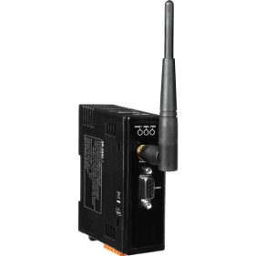
Protocol Stack
Thing
Thing
Application
Application
TCP/UDP
TCP/UDP
Network (IP)
Network (IP)
IEEE 802.15.4 PHY/MAC
IEEE 802.15.4 PHY/MAC
Wireless Medium
Server
Application
Gateway
TCP/UDP
Network (IP)
Network (IP)
The Internet
IEEE 802.3 (Ethernet)
IEEE 802.3 (Ethernet)
IEEE 802.15.4 PHY/MAC

